Slide 1
02
Exploratory Data Analysis

Slide 2


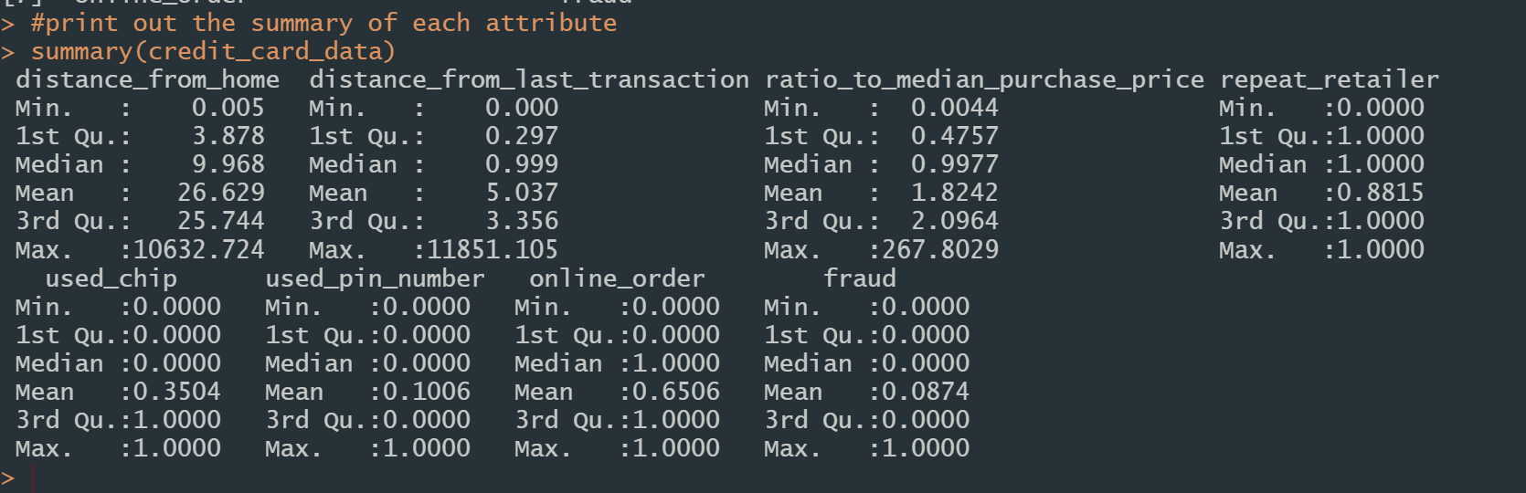
EDA - Summary
8 attributes
1,000,000 observations

Slide 3
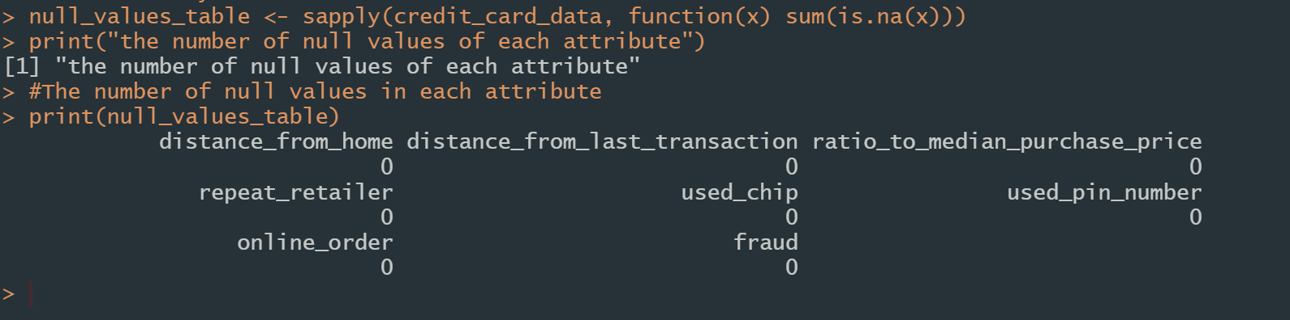
EDA - Missing Values
No null value in this dataset
Notes:
In the summary table in the previous slide, it shows that there is no negative value in each attribute

Slide 4
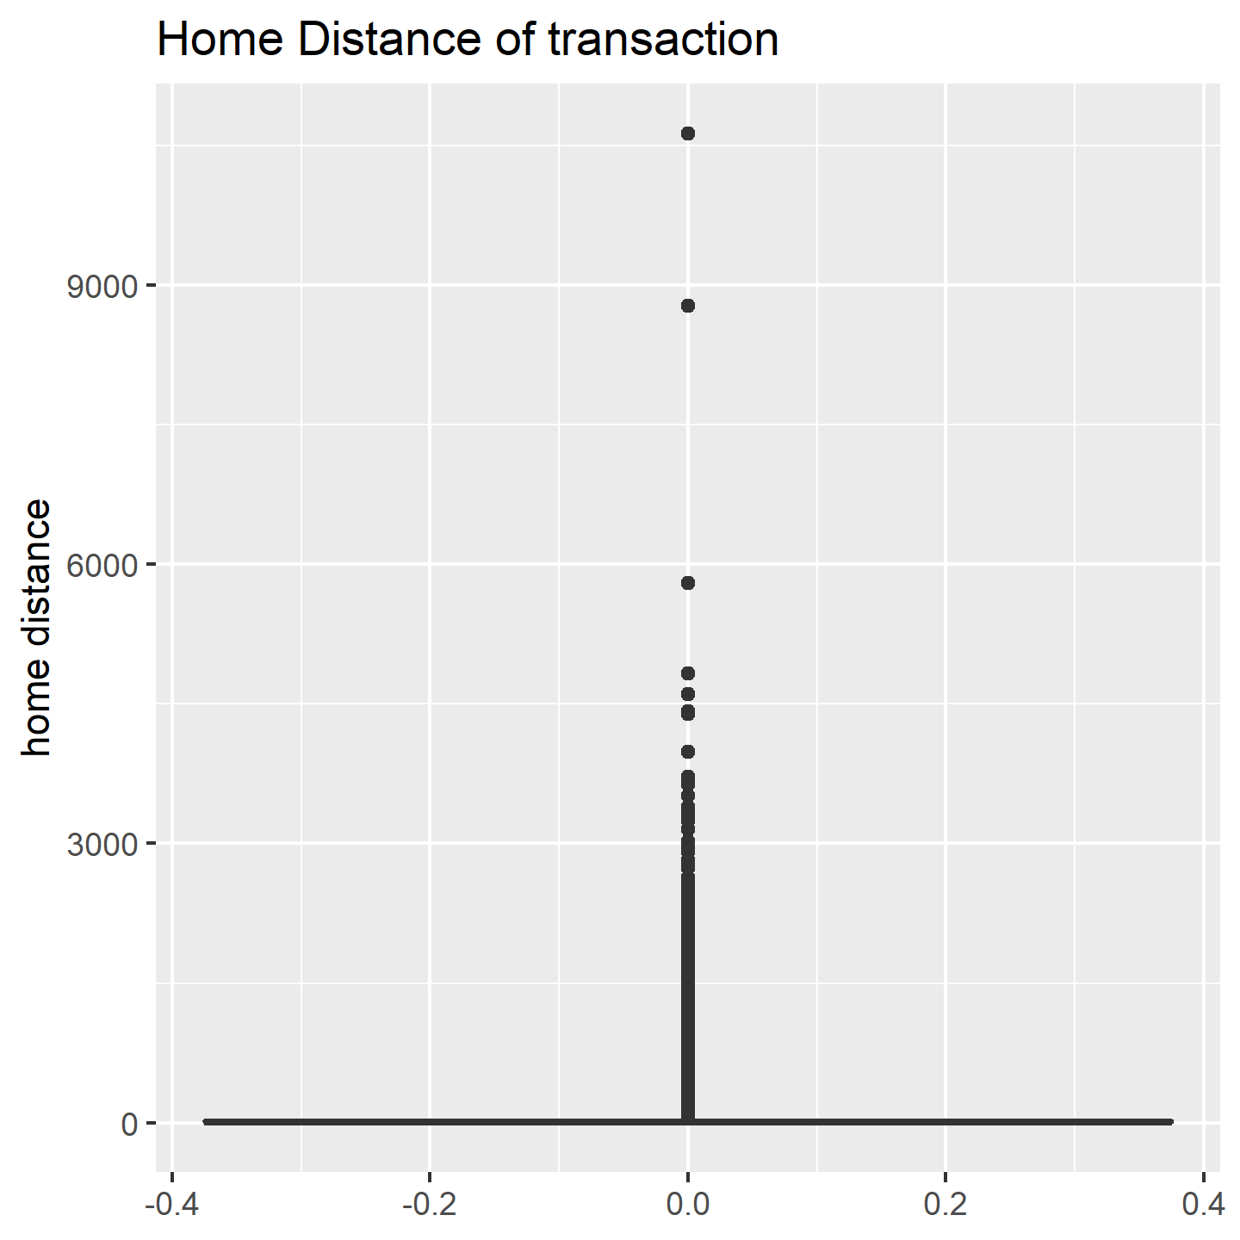
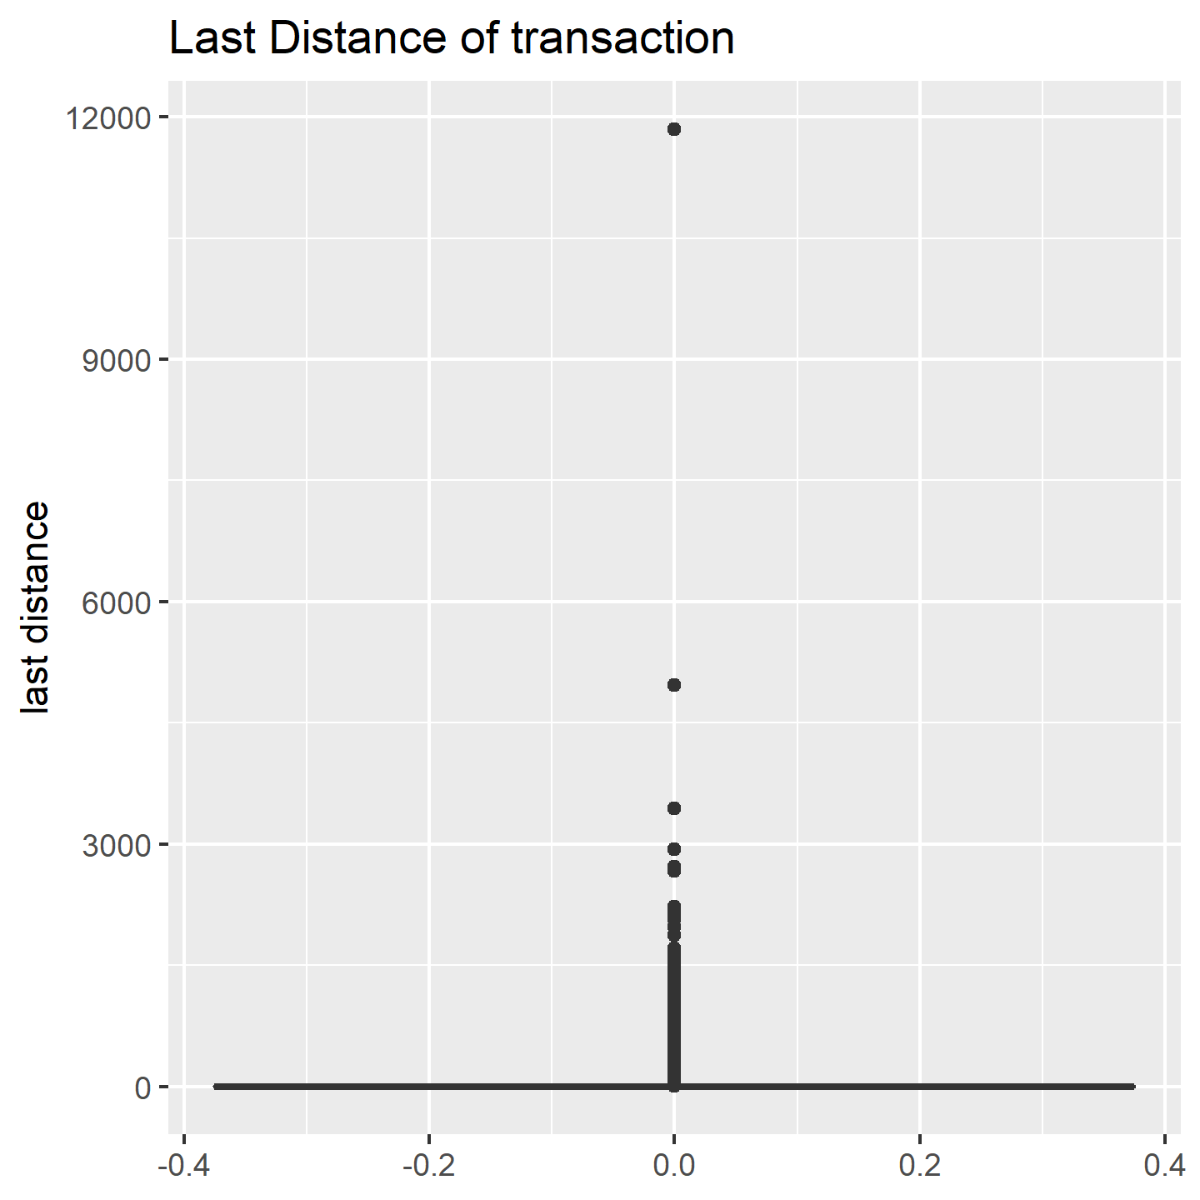
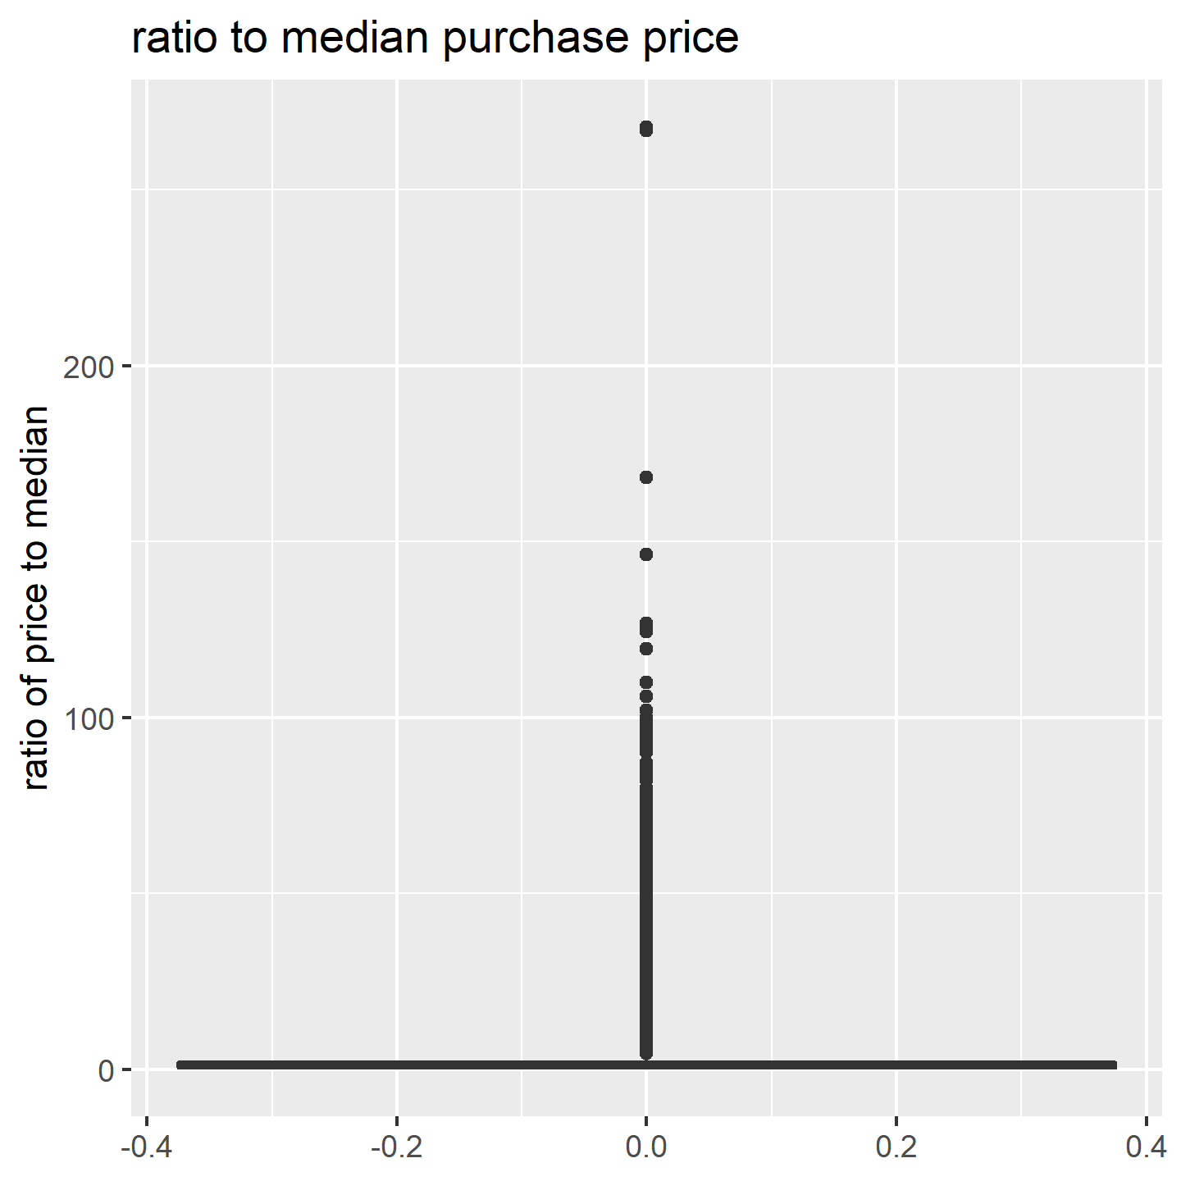
EDA – Outlier Analysis
No negative value in every attribute
Individual extreme cases
Notes:
In the summary table in the previous slide, it shows that there is no negative value in each attribute

Slide 5
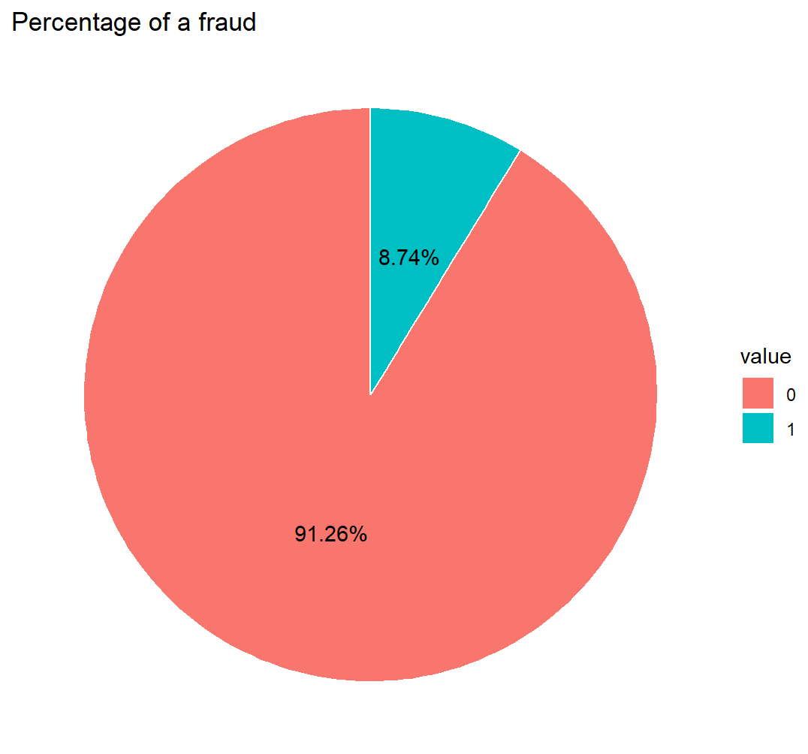
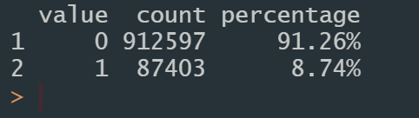
EDA – Univariate Analysis
This is an unbalance dataset

Slide 6
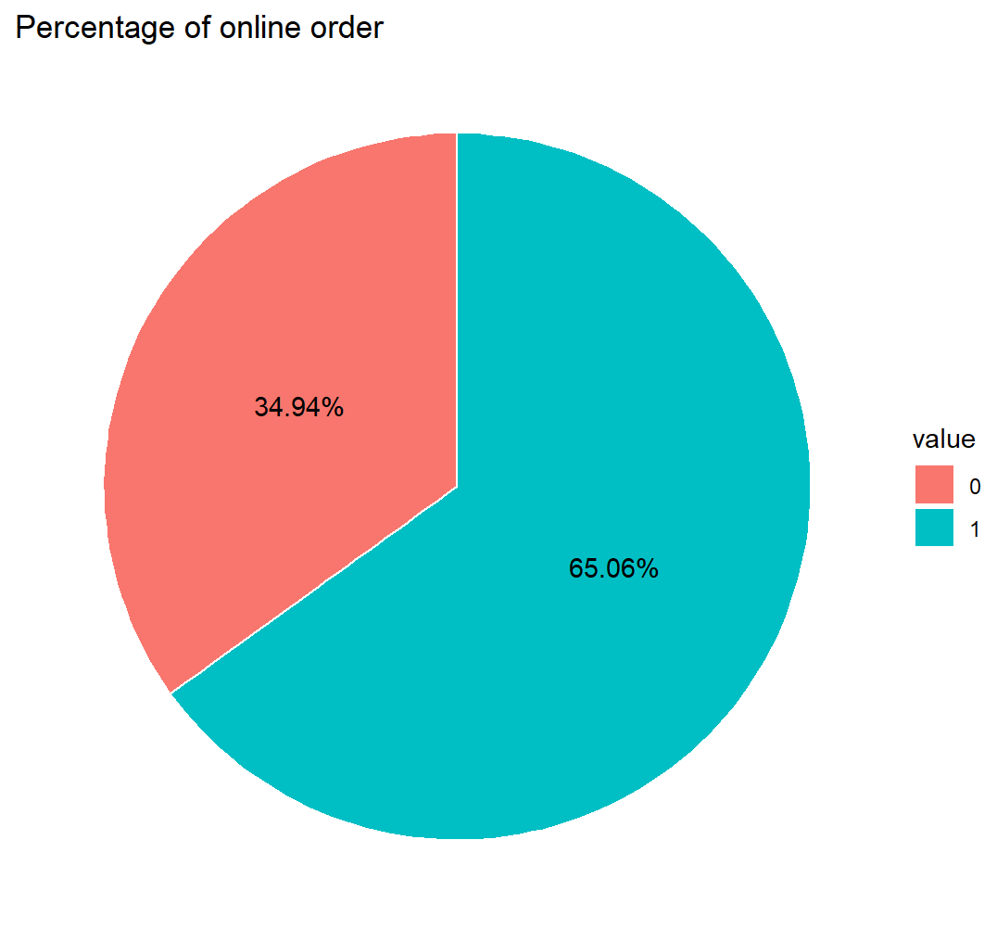
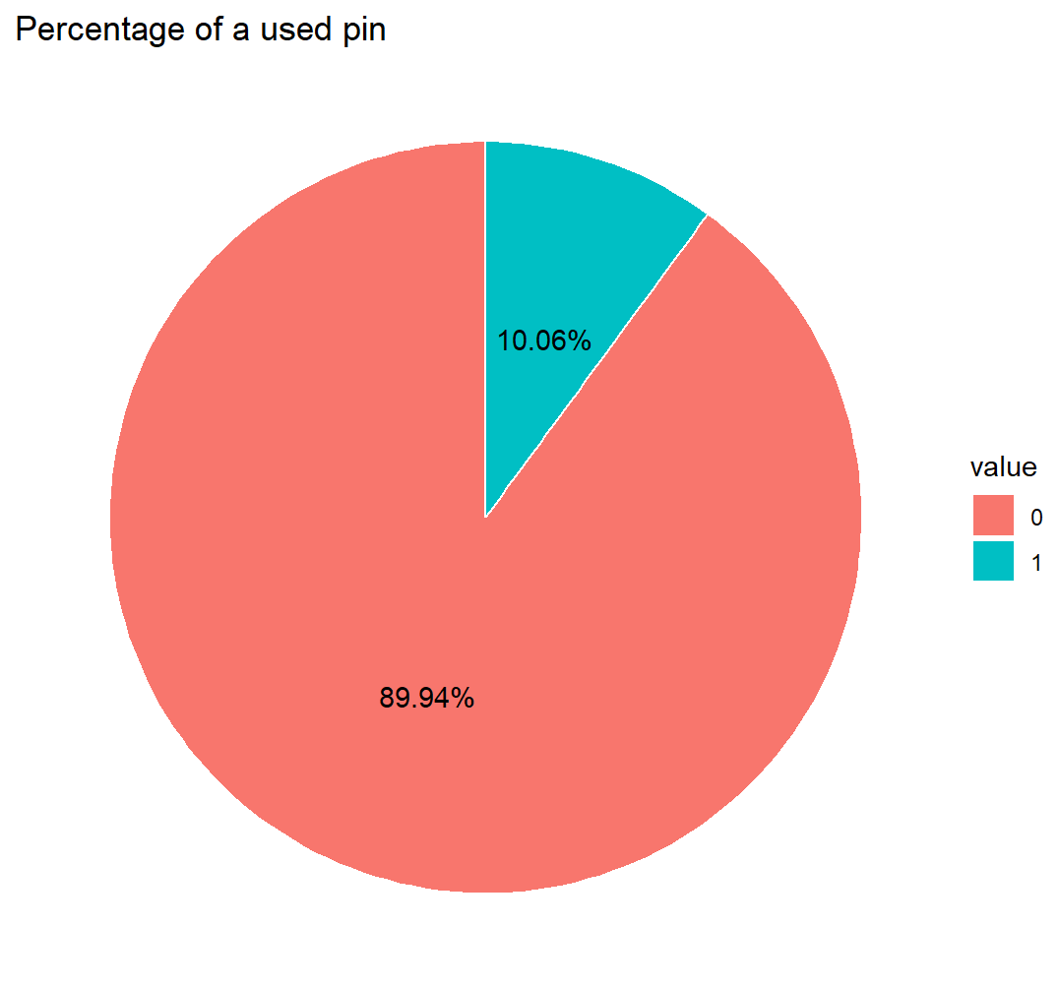
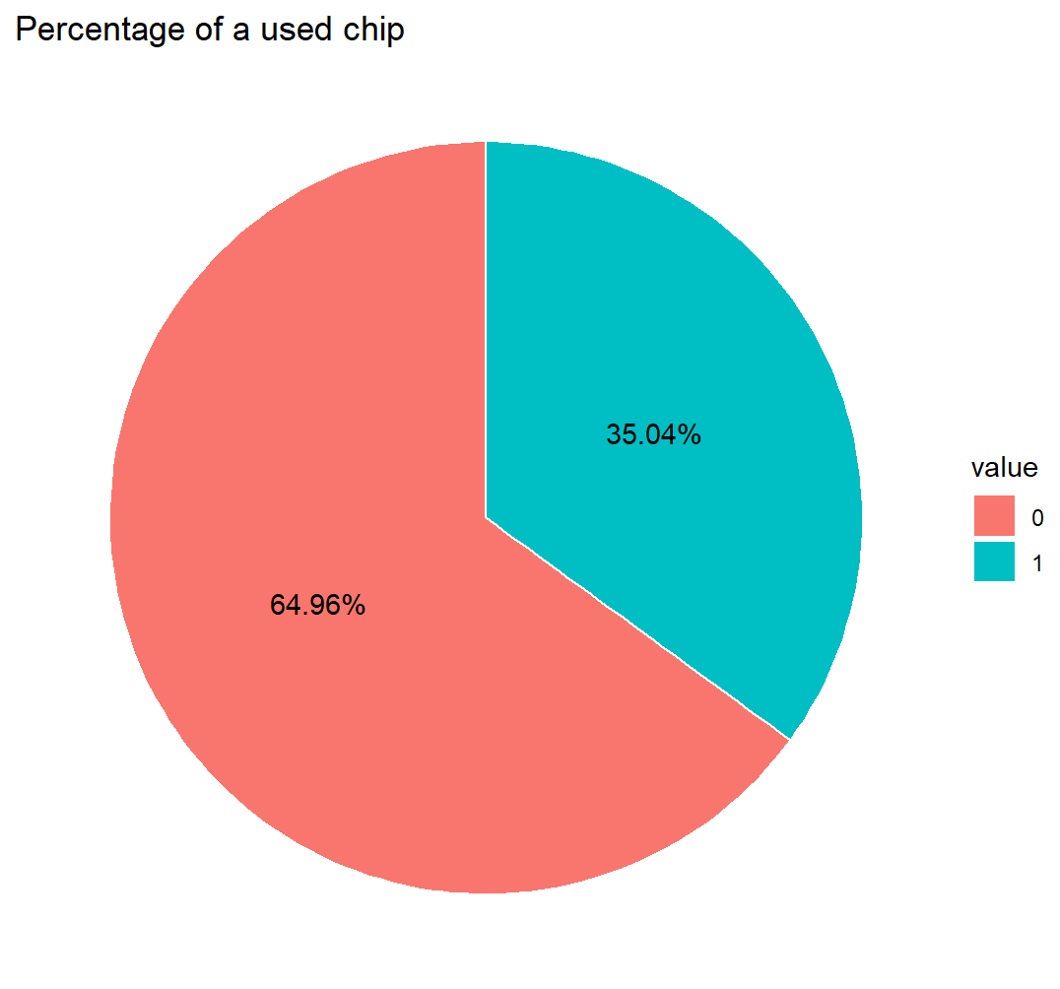
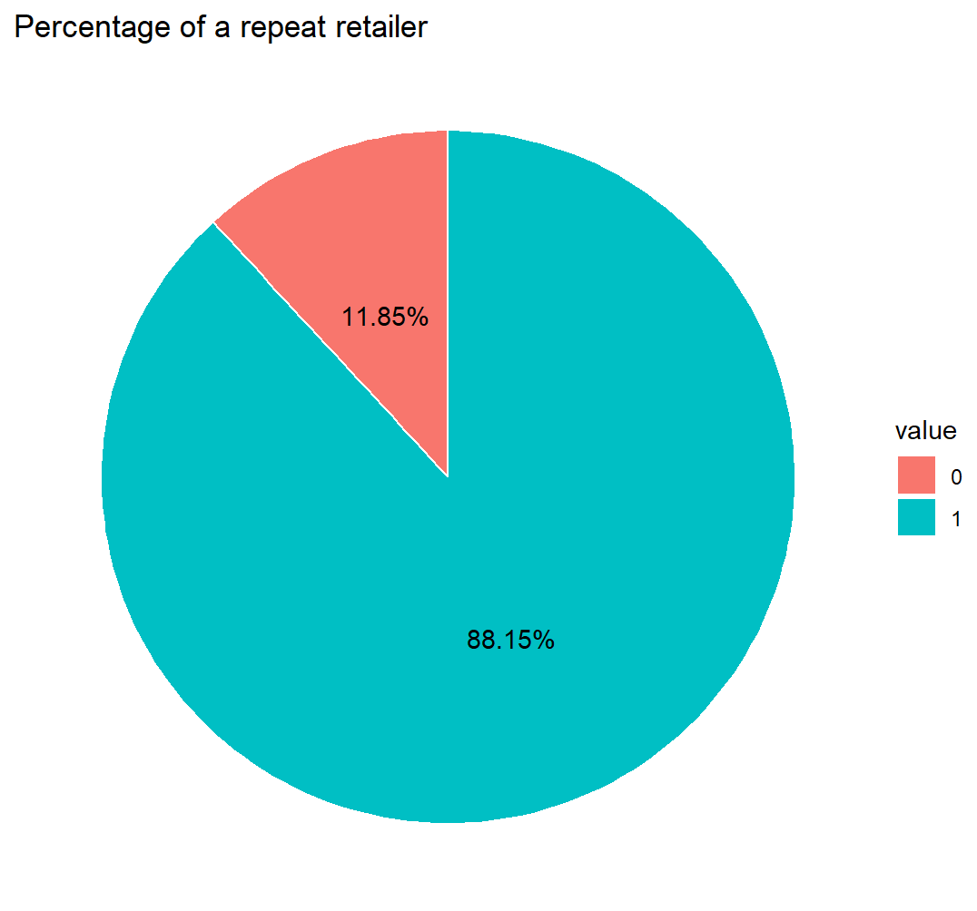
EDA – Univariate Analysis
0: not used pin
1: used pin
0: offline order
1: online order
0: not used chip
1: used chip
0: not repeated retailer
1: is repeated retailer
Notes:
The majority transactions in this dataset is online orders.
Most transactions do not use pin

Slide 7
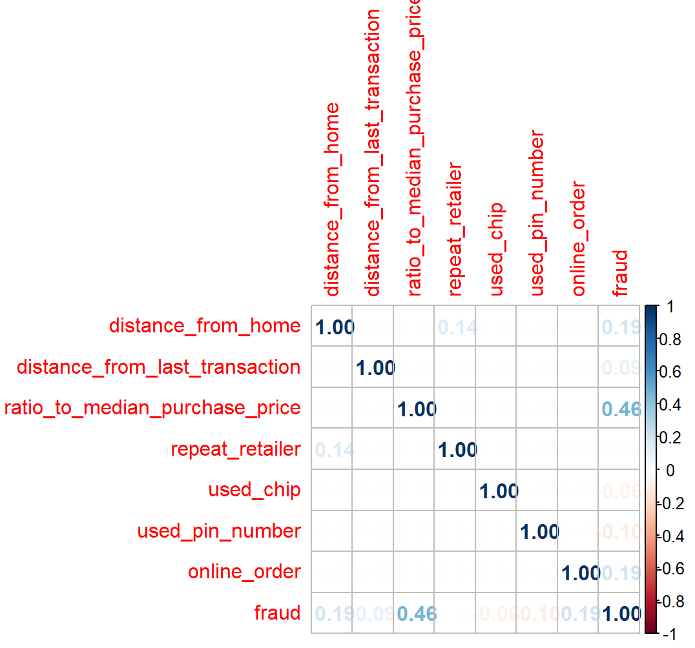
EDA – Correlation Heatmap
Correlation to fraud
ratio_to_median_purchase_price: high (0.46)
distance_from_home: low (0.19)
online_order has slight: low (0.19)
Notes:
The purchase price is the dominant factor that decides if the cases is a fraud cases.
While there are also some attributes like distance from home, online order, etc has a slighter effect on the decision

Slide 8
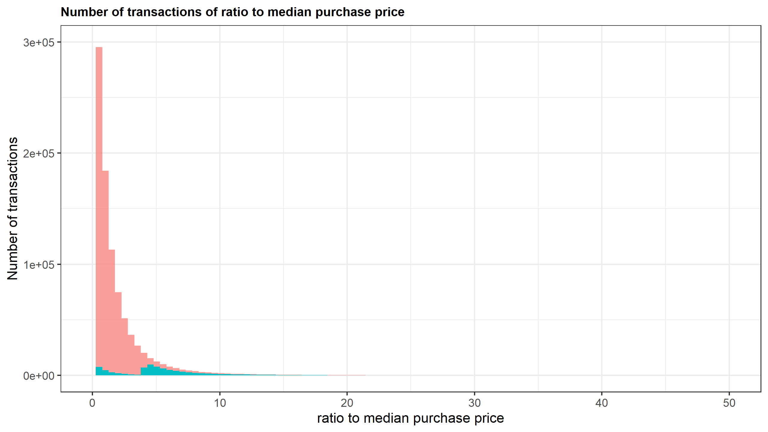
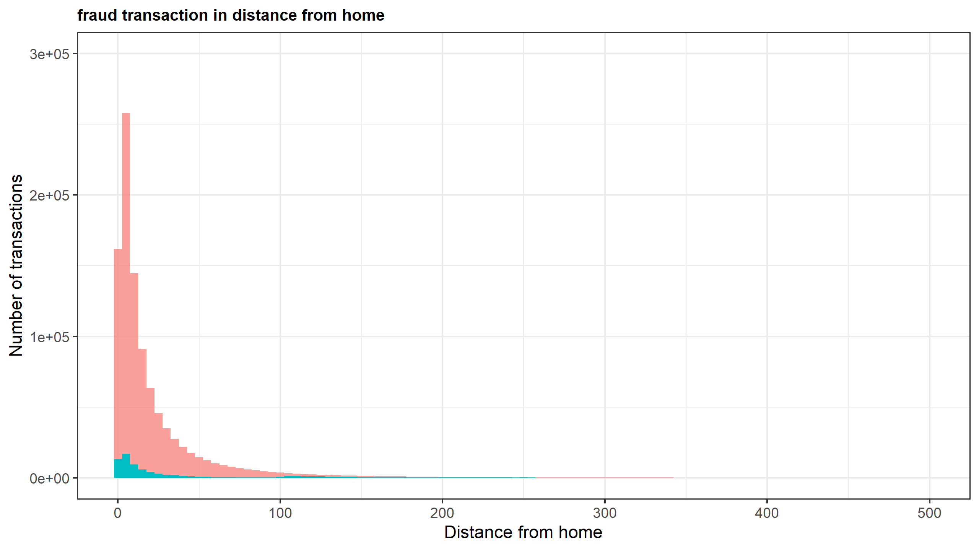
EDA – Bivariate Analysis
Red: normal transactions
Blue: fraudulent cases
Notes:
Both normal and fraud cases have a small value in distance from home.
The pattern of fraud cases generally follows the normal cases.
There is a feature in this ratio to median purchase price.
With the normal cases mainly centralized in values that is around one, the fraudulent cases can be divided into two parts: small ratio part and high ratio part.
The percentage of fraud cases is high when the ratio to median purchase price is also high.

Slide 9
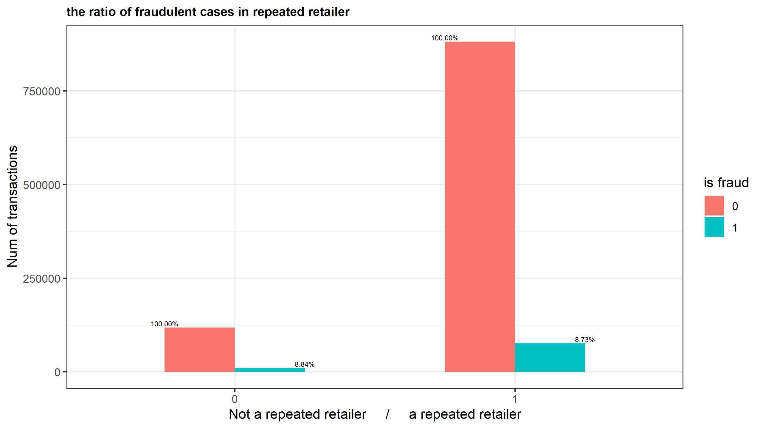
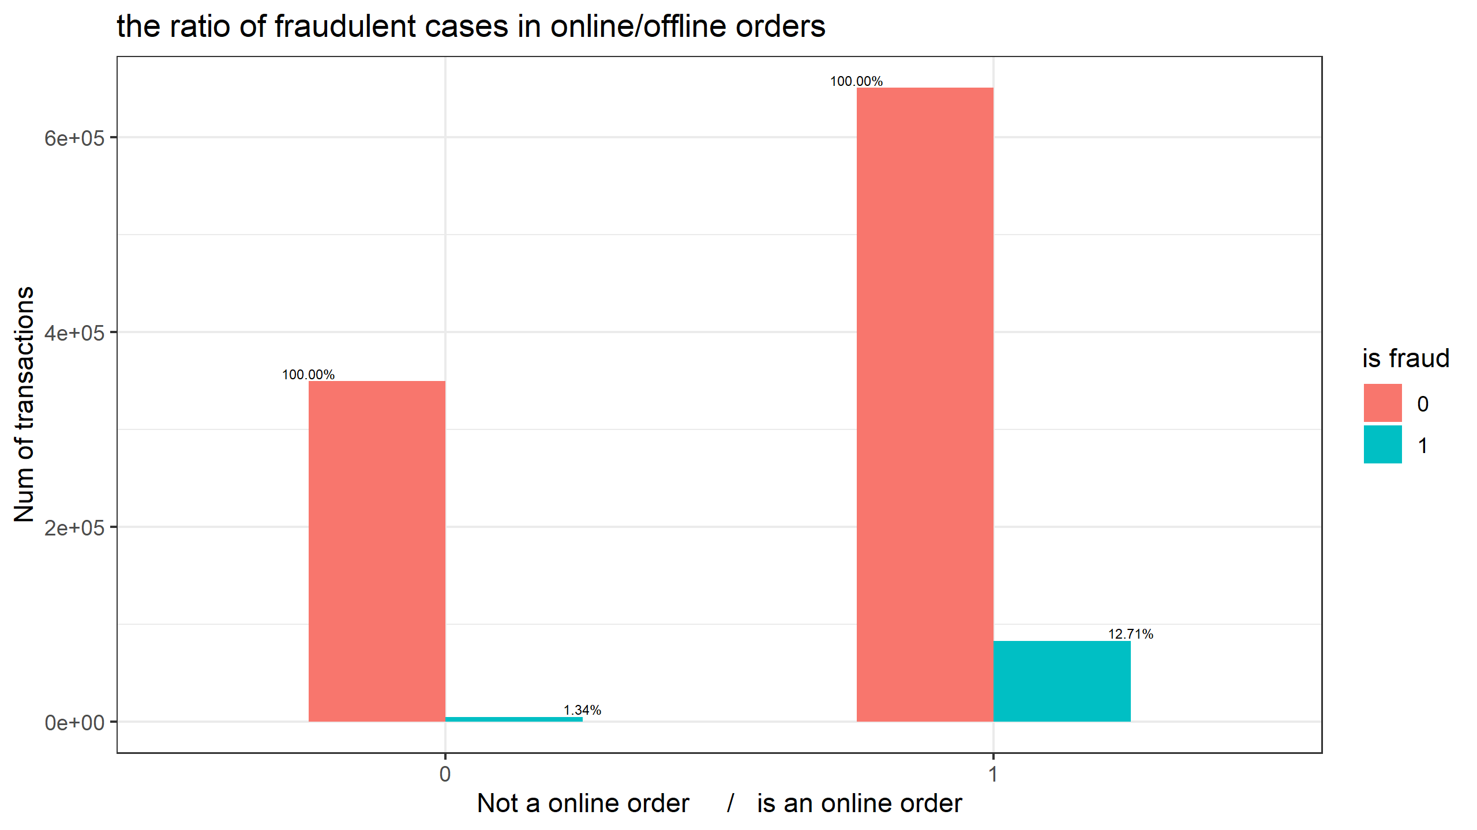
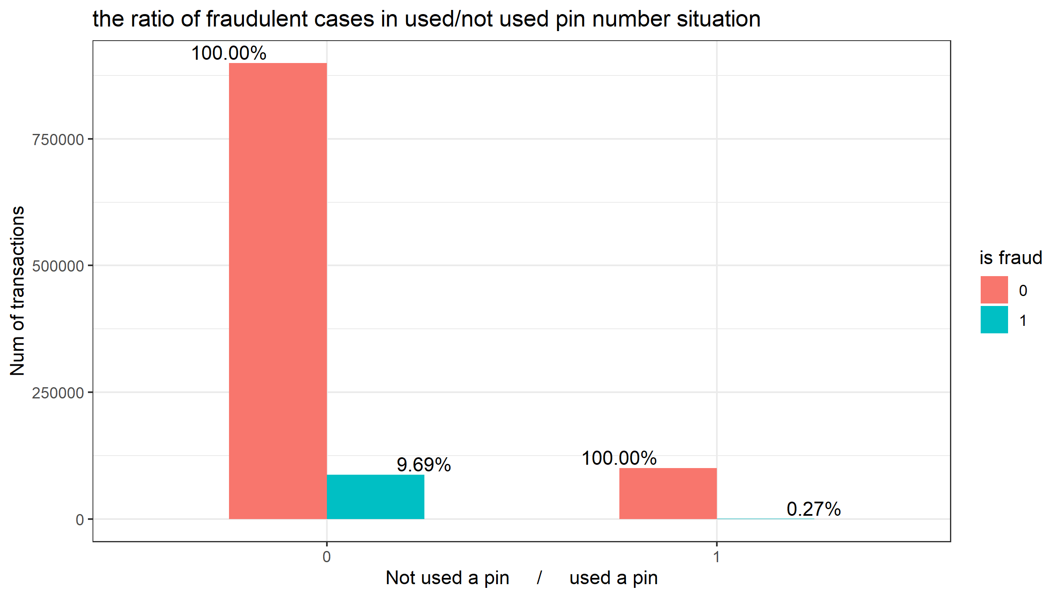
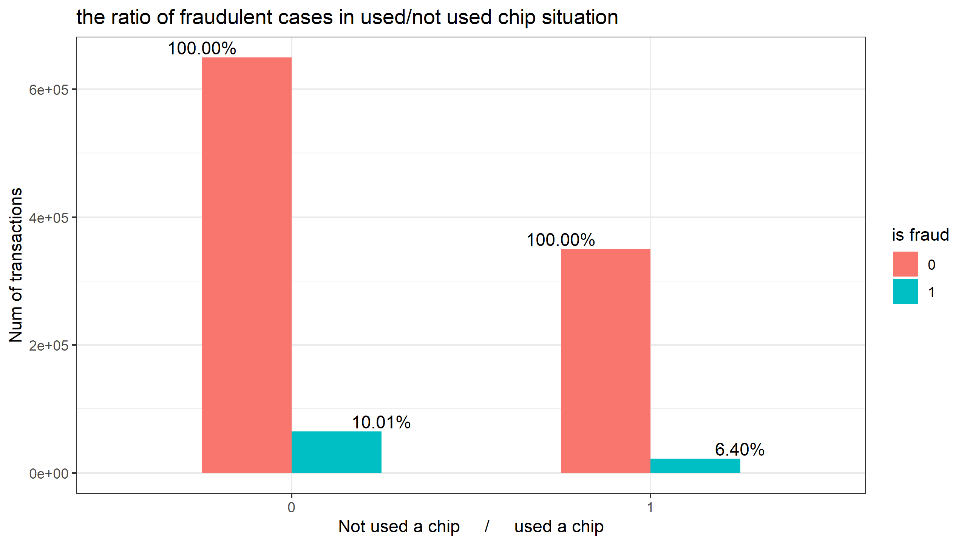
EDA – Bivariate Analysis
8.73%
12.71%
8.84%
1.34%
12.71% is fraud
1.34% is fraud
9.69%
10.01%
0.27%
6.40%
Notes:
The fraud percentage of online order is a lot higher than offline order.
The fraud percentage of used pin cases is a lot lower than not used pin cases.
Repeated retailer is not relevant to fraud.

